Slide 1


Yambopy: tbwannier module
R. Reho and Z. Zanolli
Debye Institute for Nanomaterials Science, Utrecht University
r.reho@uu.nl
MLXWF and Real-Time simulations

Slide 2

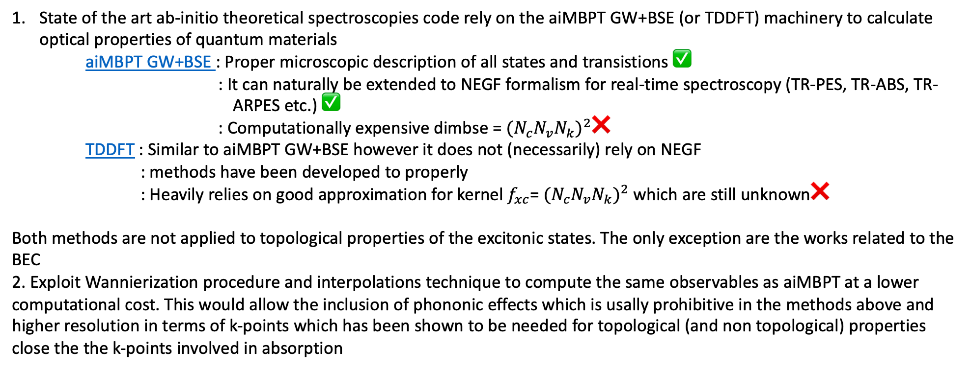
Goals and perspective
State of the art ab-initio theoretical spectroscopies code rely on the aiMBPT GW+BSE (or TDDFT) machinery to calculate optical properties of quantum materials aiMBPT GW+BSE : Proper microscopic description of all states and transistions ✅ : It can naturally be extended to NEGF formalism for real-time spectroscopy (TR-PES, TR-ABS, TR- ARPES etc.) ✅ : Computationally expensive dimbse = ${{(N}_{c}N_{v}N_{k})}^{2}$❌ TDDFT : Similar to aiMBPT GW+BSE however it does not (necessarily) rely on NEGF
: methods have been developed to properly : Heavily relies on good approximation for kernel $f_{xc}$= ${{(N}_{c}N_{v}N_{k})}^{2}$ which are still unknown❌
Both methods are not applied to topological properties of the excitonic states. The only exception are the works related to the BEC
2. Exploit Wannierization procedure and interpolations technique to compute the same observables as aiMBPT at a lower computational cost. This would allow the inclusion of phononic effects which is usally prohibitive in the methods above and higher resolution in terms of k-points which has been shown to be needed for topological (and non topological) properties close the the k-points involved in absorption

Slide 3


tbwannier structure
wann_io
→ IO from wannier90 (.amn, .mmn, .nnkp, .hr, etc.)
coulombpot
→ Model coulomb potentials (2d, 1d, 0d, Rytova-Keldysh etc…)
wann_model
→ Build TB Hamiltonian, ground state properties
wann_H2P
→ Build 2-particle Hamiltonian for BSE equation
yambopy
wannier
wann_dipoles
→ Compute dipoles (position/velocity/covariant gauge)
wann_occupations
→ Define occupations functions (FD, Boltzmann, Bose)
wann_lifetimes
→ Compute exciton lifetimes
wann_utils
→ Mix of useful functions as a class ChangeBasis() (bloch to wann and wann to bloch)
NB: Code works (mostly) in atomic units
wann_Gfuncs
→ Define Green’s function in the NEGF formalism

Slide 4
K-grid : wann_tb_mp
2 classes to handle the k-grid : tb_Monkhorst_Pack(sisl.physics.MonkhorstPack): employ sisl to create a uniform k-grid, not compatible with wannier90 due to the different conventions in the k-grid generation and the neighbours.
NNKP_Grids(NNKP): build a k-grid compatible with the wannier90. In particular, reads and uses the same b-vectors involved in quantities such as the overlap involving the k+b vectors. Contains useful mapping functions for k and q grids ( q+b, k-q, k+b/2, k-q-b/2) and folding points back in the first BZ, retaining the translational G-vectors.
Issues
- Missing optimization from IBZ to full BZ using symmetries from spglib. While the mapping of the k-points might be feasible, it is not clear how to transform the Bloch functions and BSE quantitis.
The uniform k-grid generated by Yambo after removing the symmetries is incompatible with wannier90. Moreover, this grid seems to be odd w.r.t QE. For example, for LiF a 4x4x4 grid in QE gives 10 points in the IBZ and 64 in the full BZ. Yambo recognizes 10 points in the IBZ but expand to 256 in the full BZ. Moreover, it assign a grid of 8x8x8. Additionally, remember that Yambo works in i.k.u. units and internal functions of yambopy are available to convert from iku to QE units
Without compatibility between the grids is impossible to integrate the Kernel K computed by Yambo with tbwannier

Slide 5
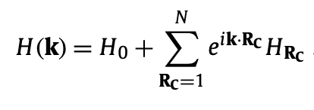
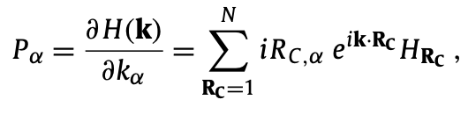
TB Hamiltonian : wann_model
Class TBMODEL(tbmodels.Model): gives possibility of building the Hamiltonian from tbmodels or internally from a HR Object read from wannier90 (_hr.dat)
Solves the Hamiltonian for each k-point, giving the possibility of plotting the band structure.
Computes the light-matter Hamiltonian
Stores important quantities such as the eigenvectors, eigenvalues, occupations and the transition table
Issues
Missing interpolation routines
The accuracy of the band structure and its dispersion has not been widely tested and we spotted few differences between the bands computed with tbmodels and internally from _hr.dat

Slide 6
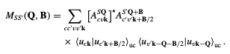
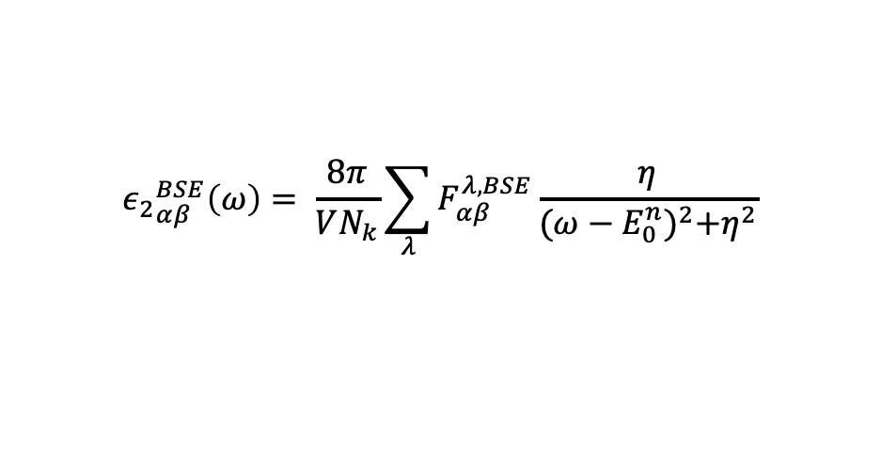
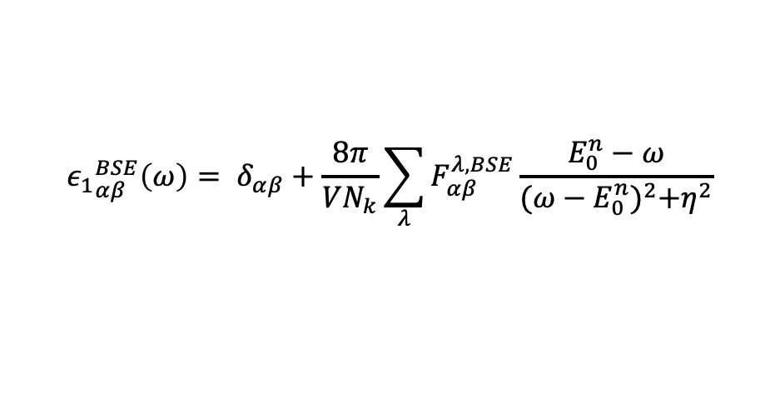
H2p Hamiltonian : wann_H2p
Class H2P: builds the resonant part of the BSE Hamiltonian following the Onida formalism in the TD approximation. In the future, we might include the possibility of building full BSE Hamiltonian (w/o TD, coupling, particle-particle channels etc..)
Kernel build from a model Coulomb potential or Yambo Kernel.
If a second q-grid is present, which should be half a size of the k-grid, it solves the BSE for each q-point.
It gives the possibility to compute absorption and the exciton overlaps.
$${ε_{1}}_{αβ}^{BSE}\left(ω\right)= δ_{αβ}+\frac{8π}{VN_{k}}\sum_{λ}{F_{αβ}^{λ,BSE}\frac{E_{0}^{n}−ω}{{(ω−E_{0}^{n})}^{2}+η^{2}}}$$
$${ε_{2}}_{αβ}^{BSE}\left(ω\right)= \frac{8π}{VN_{k}}\sum_{λ}{F_{αβ}^{λ,BSE}\frac{η}{{(ω−E_{0}^{n})}^{2}+η^{2}}}$$
Absorption
Issue
While we have routines to read the BSE Kernel from Yambo in transitions space the incompatibility with the grids prevents from us to use this feature
PL_0 still to be bug-fxied
Missing a correct computation of the initial exciton projections both from a theoretical and computational point of view. Wannier90 expect a .amn file which should give an hint of the initial trial functions
There might be unknown bugs as absorption.

Slide 7
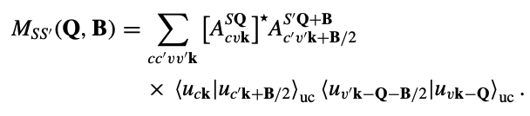
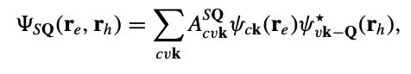
Exciton overlaps: wann_H2p
Exciton overlaps
It is possible to compute this overlap for each S and S’. The code maps the k, k+B/2, Q+B, k-Q-B/2, k-Q quantities.
It is not clear to me how the summation works, for each transition I have only one c, v and k. If it implies the case of degenerate solutions of the BSE I wrote a function that checks the degeneracy of the BSE eigenvectors, which however has not been tested.
I am not sure if one should compute the overlap matrix for all transistions S ( = dimbse) or only for the states which are of interest. The second option makes sense to me, one might want to study the S=S’=0 excitons.
As a proof of concept, I tried to compute these overlaps, along with the .amn .nnkp and .eig file and feed those file to wannier90.
Eventually, the code run but crashed before reaching the end of the disentanglement procedure.
Since the idea is to compute the disentanglement U function from Wannier90 I assume that is ok to replace the initial geometrical structure with a fake atom at the origin with only an s-projection. I don’t know if this is the correct procedure.
For the initial projection .amn I tried to feed the exciton wavefunction for S=0

Slide 8
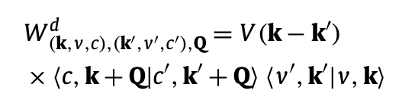
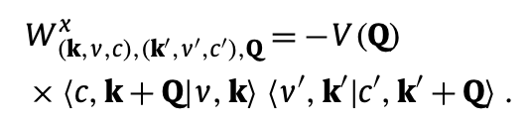
Kernel: wann_H2p
direct
exchange
Currently, the Kernel is build from a model Coulomb potential according to the equations above.
Question: Is it possible to transform the Kernel from Yambo in cvk space in Wannier space?
A generic 4-point correlation function can be written as
I tried to transform it to Wannier space according to Eq. 9 and 10 in EPW Theory paper (next slide)
But the formulas need to checked and rederived. I am quite hesitant that they are correct.
The idea is to use the same trick as for the electron-phonon coupling elements which allows to move back and forth from Wannier to Bloch space interpolating to a desirable number of k-points.

Slide 9
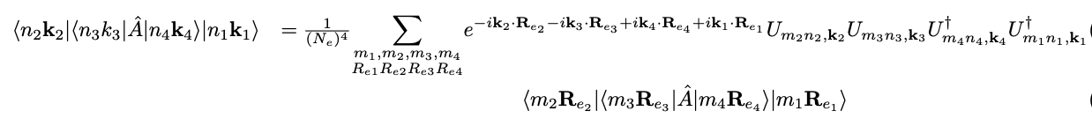
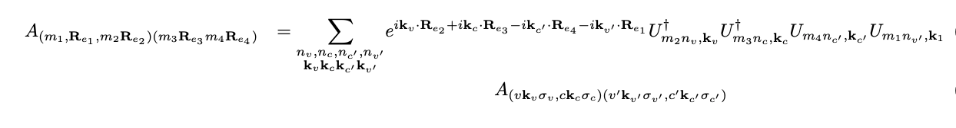
Kernel: wann_H2p
Wann → Bloch
Bloch → Wann with only c,v transistions
Discussion next slide →

Slide 10
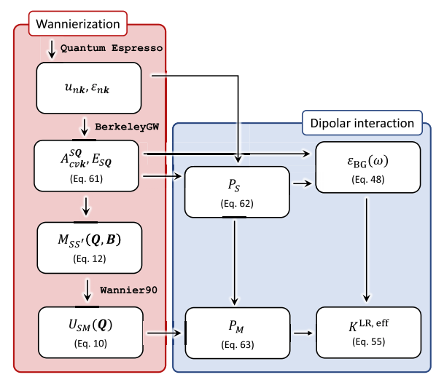
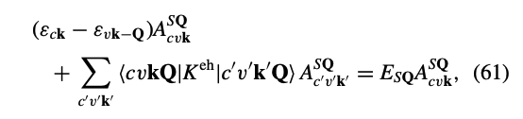
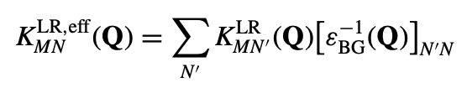
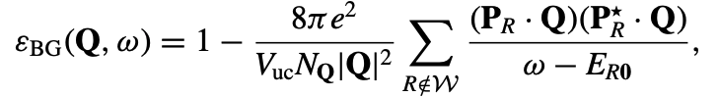
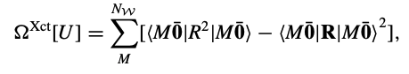
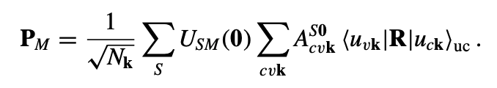
Kernel: wann_H2p
While the general shape of the formulas might be correct it would clearly be quite complicated to sum over all those indices.
Note that even though K = v – W where v and W have different (n1,n2)(n3,n4) ordering we can treat K as a unique object.
In the future, one would have to remove the long-range component of the Kernel. The procedure is complicated and different for singlet and triplet excitations. It is described here.
Since the procedure involves quantities expanded in the G-space it’s not clear how one would have to remove this long-range component with the modelling approach.

Slide 11
Real Time Formalism
Over the past 12 years a lot of effort has ben put in the development of a real-time scheme for calculation of optical properties suchs as TR-Abs, TR-ARPES, TR-PL, TR-PES etc…
The formalism need to include the coherence and decoherence process involved in the excitation of carries from a pump laser and relaxation process due to: 1) e-e scattering. Polarization of the medium due to the hole in valence band 2) e-phonon scattering 3) e-photon scattering
4) plasmonic resonances
A series of controlled approximation tuned to reproduce the experimental setup have been developed in aiMBPT (Yambo community + Stefanucci&Perfetto) and TDDFT (A. Rubio and others)
Here, I just highlight a series of relevent papers - C. Attaccalite, M. Grüning, and A. Marini (2011)
Andrea Marini, Enrico Perfetto, Gianluca Stefanucci (2022)
D. Sangalli (2021)
Giovannini, Sato, Hübener , Angel Rubio (2022)
Steanucci1 (2023) Stefanucci2 (2023)
DMFT

Slide 12
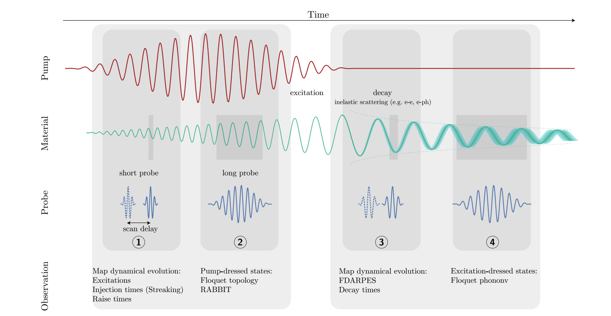
Real Time Formalism: Setup in mind

Slide 13
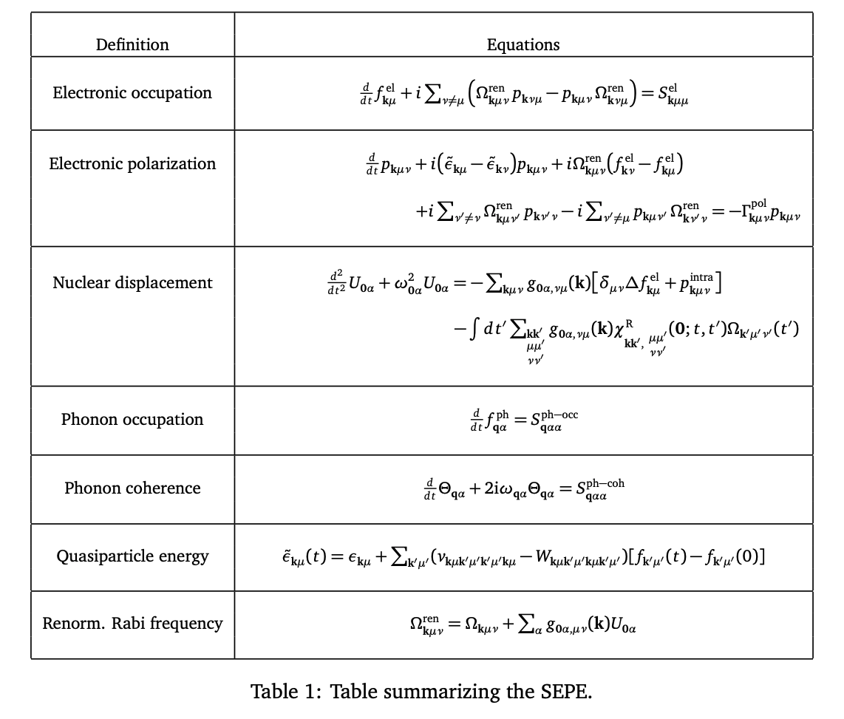
Real Time Formalism
In particular, the papers by Stefanucci et al. in 2023 discuss the SEPE equations which combines NEGF theory in the GKBA and mirrored GKBA for modelling of time-resolved absorption and ARPES experiments.
My goal, would be to implement such equation in the light of the Wannierized model with electron-phonon coupling read from EPW.
The theory is quite involved and complicated but the main equations are summarized in Table1 of the paper. A real implementation might need discussion with these thoreticians which I can have at the DPG meeting in Berlin (March 2024)

Slide 14
Real Time Formalism: Implementation
Implementing this equation require a deep understanding of the IO and convention used in QE-Yambo-EPW. Therefore, I would discourage to start with an ab-initio implementation but rather trying to work with a small and interesting system with perhaps a modelling approach.
TODO: - parsing of the electron-phonon coupling g
- solver for time-dependent linear differential equation (yambo_rt has routines that do this)

Slide 15
Code validation

Slide 16
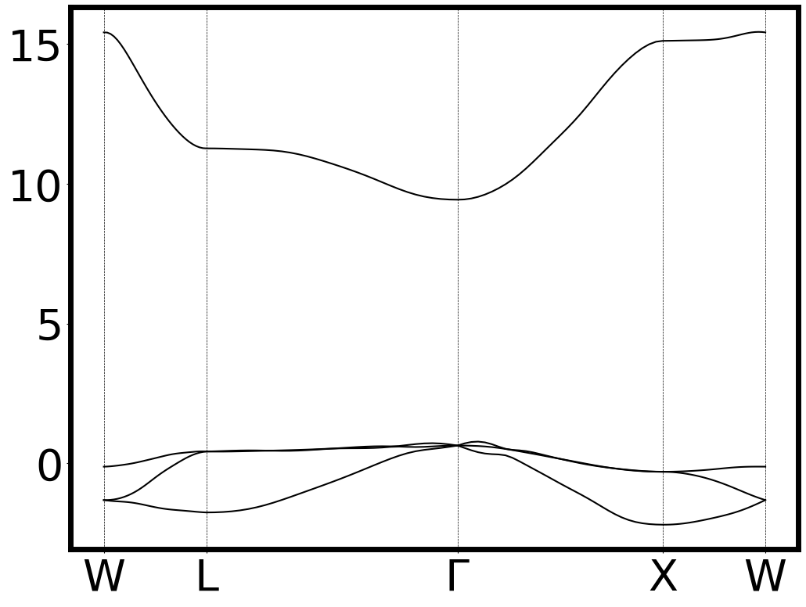
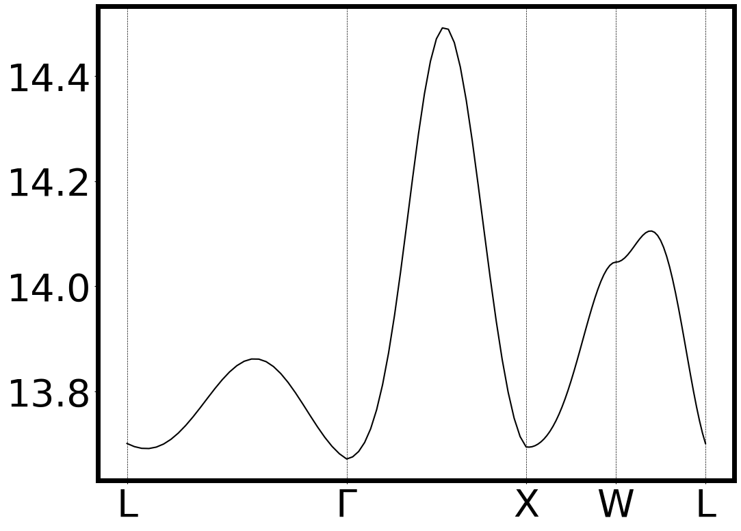
Band structure
Electronic band structure: Check that wannierization +
Internal functions for building H(k) works
TODO : plot on top DFT bands from pw.x
Excitonic band structure: Check that exc wannierization + exc overalap works.
To be compared with Yambo exciton band structure.
It is different then the one in the MLXWF paper.

Slide 17
Band structure
Electronic band structure: DFT 12x12x12
Wannier 8x8x8
Electronic band structure: DFT 12x12x12
Wannier 4x4x4

Slide 18
Orbital projected bands
Electronic band structure: DFT 8x8x8 unshifted grid

Slide 19
Band structure
Electronic band structure: DFT 8x8x8 unshifted
Wannier 4x4x4
Electronic band structure: DFT 8x8x8 unshifted
Wannier 8x8x8

Slide 20
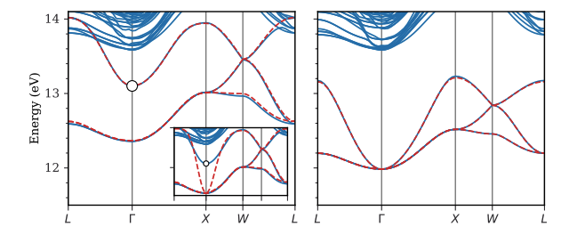
Band structure: ref paper
Exc electronic bands. Inset shows result without long-range contirbution

Slide 21
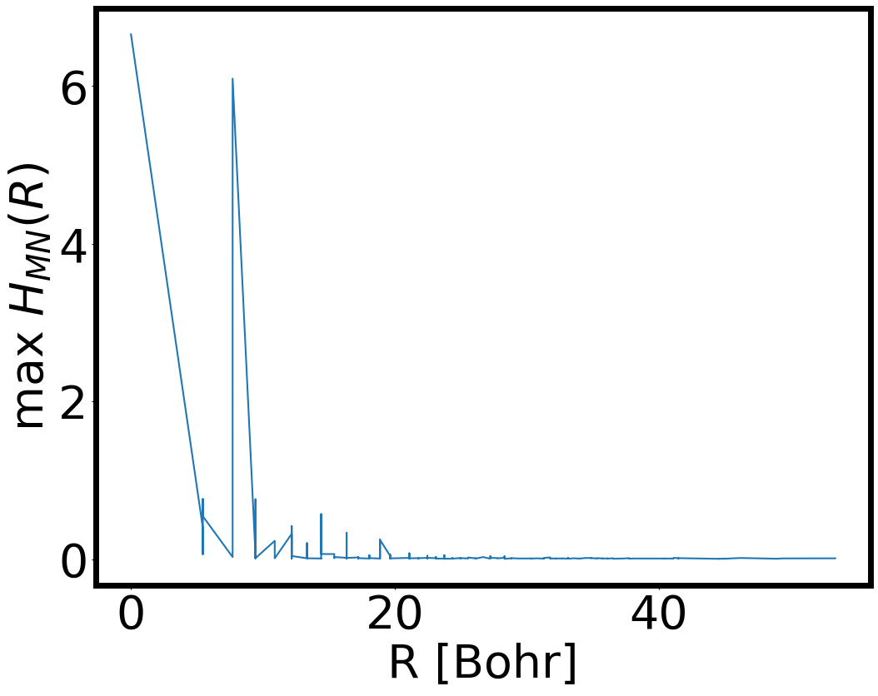
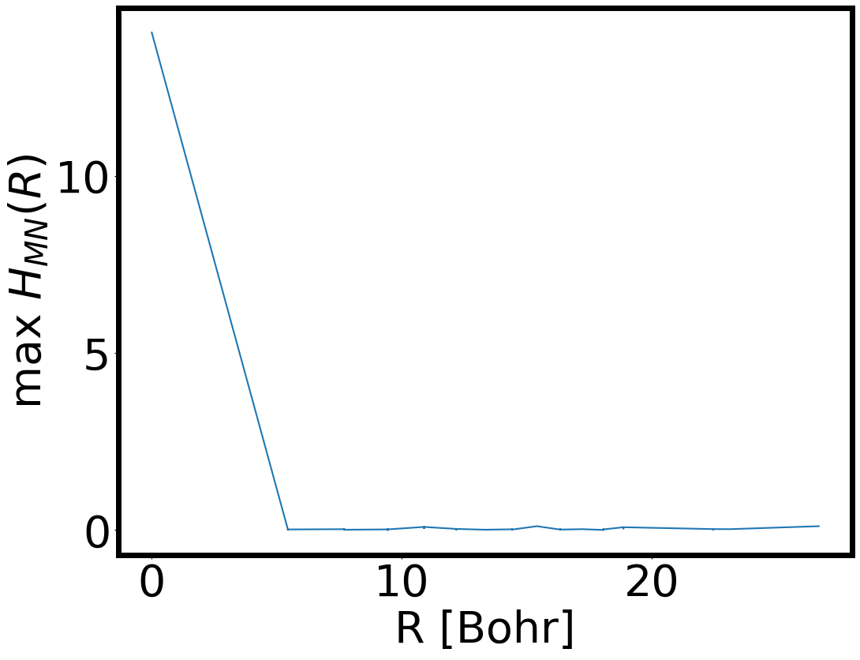
Decay of Hamiltonian
Decay of electronic H
Log scale to do
Decay of excitonic H

Slide 22
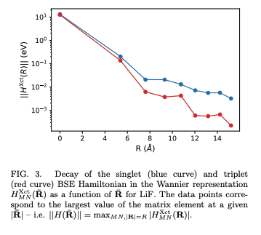
Decay excitonic Hamiltonian: ref paper

Slide 23
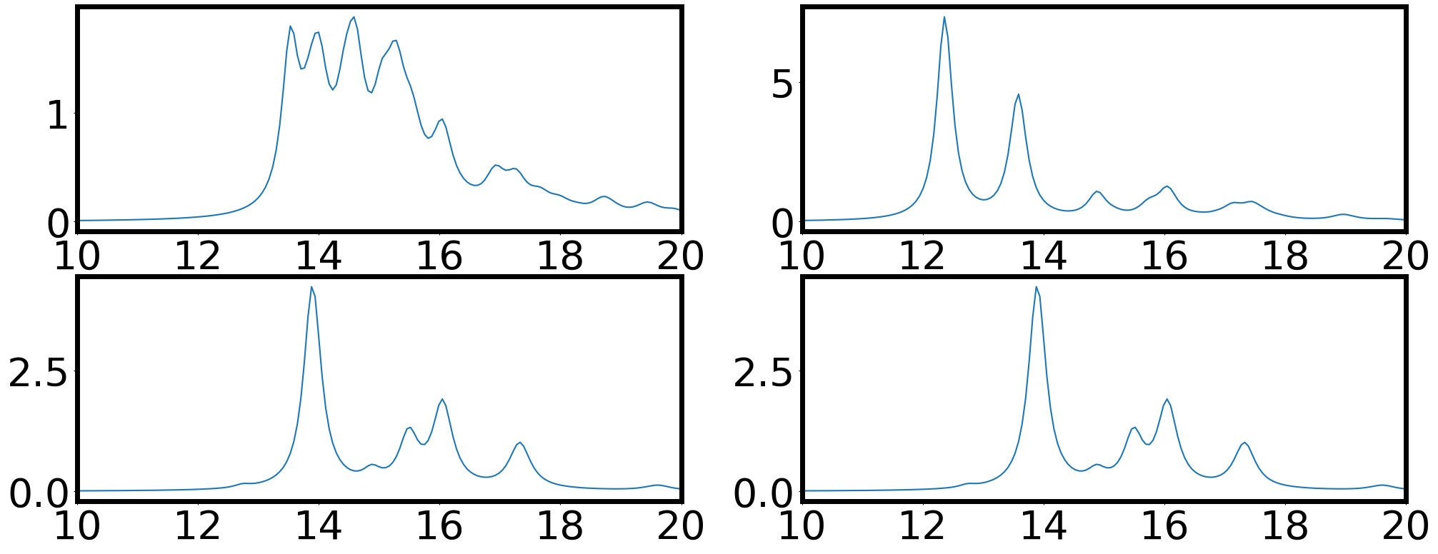
Absorption plot: Yambo
K-grid 1 c – 3 v
q-grid 1 c – 3 v
K-grid 1 c – 1 v
q-grid 1 c – 1 v
K-grid 1 c – 3 v: something went wrong in the calculation. I am redoing it

Slide 24
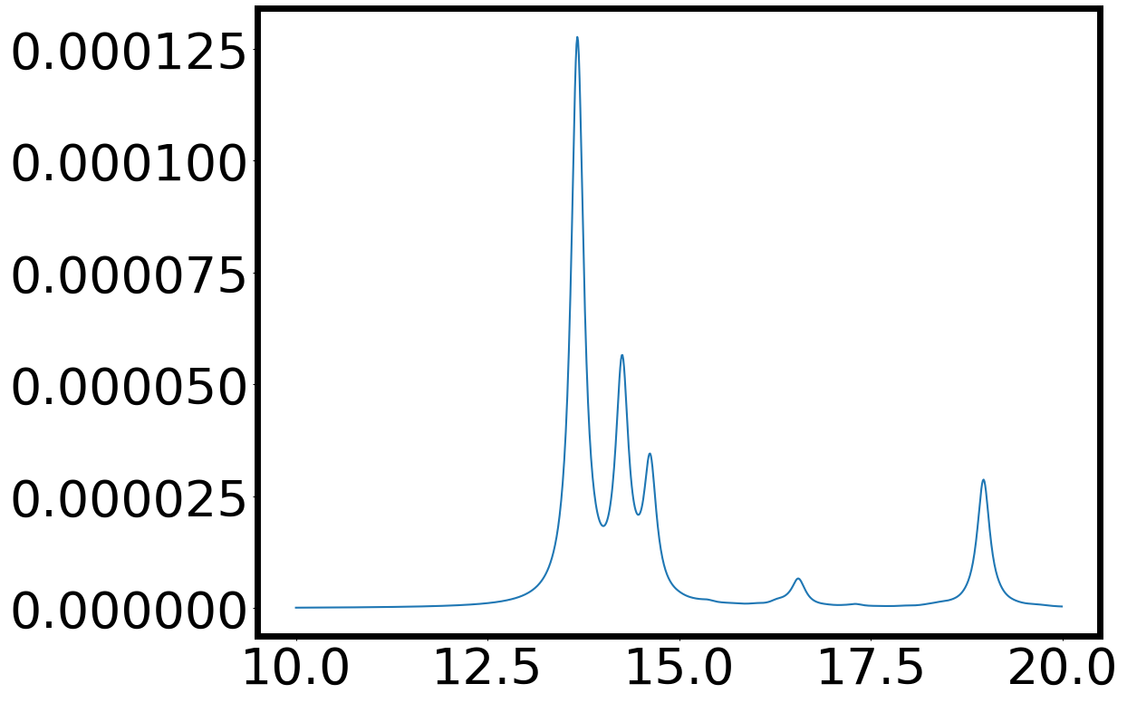
Absorption plot: tbwannier
K-grid 1 c – 1 v
K-grid 1 c – 1 v
K-grid 1 c – 3 v: something went wrong in the calculation. I am redoing it

Slide 25
Test Yambo : LiF

Slide 26
General comments
DFT : Symmetries ground state
QE recognize 48 symmetries point group O_h (m-3m) both with shifted and unshifted-grid.
Unshifted-grid → 8 k-points in nscf. (4 4 4 0 0 0)
Shifted-grid → 10 k-points (4 4 4 1 1 1)
Yambo branches:
I tested that I get same results with yambo 5.1 and my Branch fixes-photoluminescence ✅

Slide 27
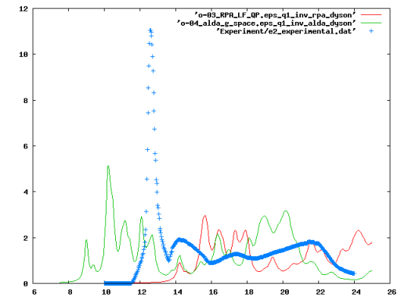
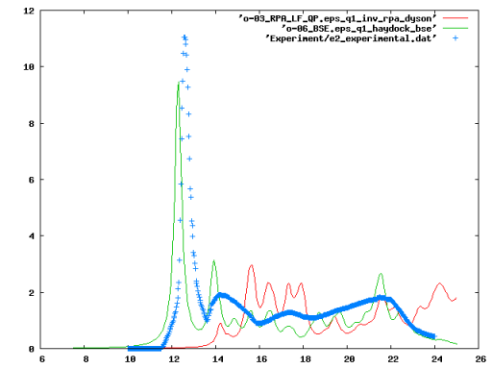
Absorption: Reproduce Tutorial plots
RR test follow yambo tutorials
Yambo-wiki
Problem : plots are not the same if I follow the wiki steps: I think there is some overwriting of databases when running steps 01->02->03 etc..

Slide 28
Absorption: Reproduce Tutorial plots
RR first run 06_BSE and then 02,03,04,07
Yambo-wiki
Problem solved: I am able to reproduce Yambo results. I don’t know why order matters.

Slide 29
Absorption: Reproduce Tutorial plots
RR test run only 05_W and 06_BSE
Yambo-wiki
Shifted-grid reproduce Yambo result
UnShifted-grid is close to the Yambo result → two grids are not equivalent both in number of k-points and Q-points
Shifted-grid : 10 k-points and 19 Q-points
Unshifted-grid : 8 k-points and 10 Q-points

Slide 30
Exciton band structure : Ref
Ref: Maximally-Localized Exciton Wannier Functions for Solids Neaton(2023) Phys. Rev. B 108, 125118
Singlet (left panel) and triplet (right panel) exciton dispersion for LiF. Linear interpolation of exciton eigenergeies explicitly explicitly obtained by diagonalizing the BSE at 72 Q points along the high-symmetry path (blue curve). Wannier-Fourier interpolated exciton dispersion starting from a -centered 5 × 5 × 5 Q mesh (dotted red curve). The inset of the left panel shows how Wannier-Fourier interpolation performs without isolating the long-range contribution
Open questions: 1) How to obtain the singlet and triplet exciton dispersion for LiF in Yambo? Are there any special flags?
2) Why is Yambo not able this exciton band structure? I understand that it could be related to converged parameters but shouldn’t we get the right degeneracy at the high- symmetry points? [next slide for my results]

Slide 31
Exciton band structure: RR tests
RR test
Questions: 1) Why the exciton band structure looks so different than the one in the ref?
2) Why ypp does not print the high-symmetry points in the output file? I used
BANDS_path= "L,G,X,W,L” but ypp does not recognize this flag.
3) ypp does not respect the number of points set in the input file. If I ask for Bands_STEPS = 30 and I have 5 K-points I should get 121 data points, but I only get 93.
4) Does the result depends on the excitons states [States= "1 - 4” ] ? The number of exciton bands in the output is equal to the number of exciton states (lambda) but does this affect the overall bands dispersion?
W
Is this degeneracy issue in the exciton band structure at W related to ypp interpolation?
I think not, I tried to read the energy values directly from ‘ndb.BS_diago_Q*’. However, W = [0.5,0.25,0.75] and it’s not in the list of Q-points of the shifted and unshifted-grid. I checked in the shifted-grid the Q-point [0.25,-0.5,-0.25] and the first energies are:
[12.73773245+0.j, 13.20032153+0.j, 13.30764035+0.j,13.90066499+0.j, 14.29578001+0.j, 14.31913455+0.j….]
Perhaps, my grid does not contain the W point

